Slide 1

Restaurant Recommendation using ALS Approach
Ravali Nallamasu (RXN152730)
Ameya Kadam (ASK140730)
Madhuri Abnave (MXA146230)
Kanchan Waikar(KPW150030)

Slide 2

A Short Story

Slide 3
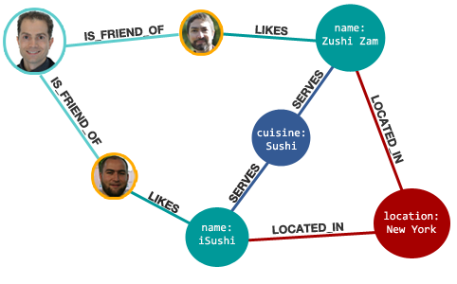
General Idea…

Slide 4
Datasets Used
Taken from Yelp Dataset Challenge
2.2 M reviews
552K users
77 K businesses
Json Input Data:
Review.json
Business.json
Sample Data
200 MB– containing 200k reviews
1mb file – containing 1k for validation

Slide 5
Data Format
{
'type': 'review',
'business_id': (encrypted business id),
'user_id': (encrypted user id),
'stars': (star rating, rounded to half-stars),
'text': (review text),
'date': (date, formatted like '2012-03-14'),
'votes': {(vote type): (count)},
}
REVIEW .json
{ 'type': 'business',
'business_id': (encrypted business id),
'name': (business name),
'neighborhoods': [(hood names)],
'full_address': (localized address),
'city': (city),
'state': (state),
'stars': (star rating, rounded to half-stars),
'review_count': review count,
.. Other attributes
}
Business .json

Slide 6
Need for big data
Size of Datasets – Huge
Redundancy Required
HDFS ??
Number of computations
Very High (~O(k3))
Matrix needs to be present In memory
100 x faster than MapReduce
Distributed Processing
Spark, Scala??
Loading huge data files, preprocessing
SPARK-SQL?

Slide 7
Why we used these tools
Hadoop:
Distributed File System and processing File System.
HDFS is used to host the input files on which the processing of data to retrieve the desired results are carried out.
storage redundancy
scale infinitely
Apache Spark:
Low Latency Computing.
Resilient Distributed datasets
parallel computing over multiple nodes in memory itself.
Efficient!
MLLib:
Inbuilt Library of Machine Learning Algorithms.
Well Tested
Speedy development of an experiment
Collaborative Filtering(CF) - ALS implementation

Slide 8

Collaborative Filtering
Yelp Has lots of data
Possibility of Opinion Bias matching
No need to analyze content of each business
Purely statistical approach
Latent Features Determination
Is food Asian?
How is the ambience?
Too Pricey???
Who has opinion bias identical to mine?
Can realize more subtle trends

Slide 9



How does ALS work
Business /User ID Ratings Matrix | 1 | 2
1 | 4.0 | 3.0
2 | ? | 2.0
3 | 3.5 | 0.0
4 | 3 | ?
Business /User ID Ratings Matrix | 1 | 2
1 | 4.0 | 3.0
2 | 2.5 | 2.0
3 | 3.5 | 0.0
4 | 3 | 2.5

Slide 10
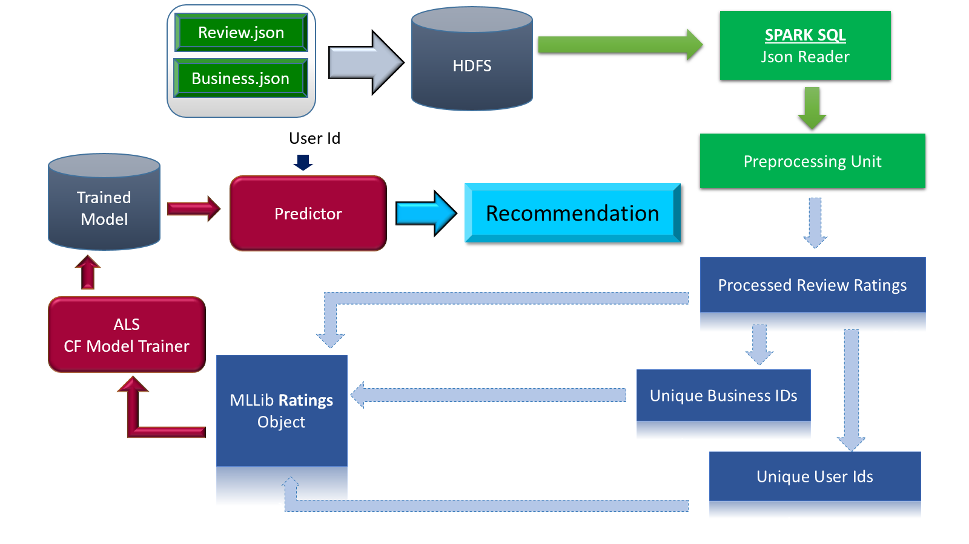
Technology Stack

Slide 11
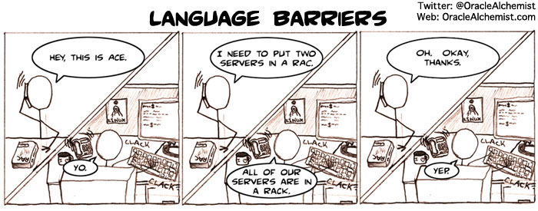
Spark MLLib did not understand json format Nor did it understand String IDs .. phew!

Slide 12
Algorithm used
Create SQL Context for loading Json
Read Json from hdfs using sql context json reader
Create tuple of UserId, BusinessId and Ratings
Remove null business ids and user ids and select distinct entries into two separate lists
Create a org.apache.spark.mllib.recommendation.Rating instance using index of user id as well as business id, Since ALS accepts only integers
Train model using ALS, give numIterations as 10 and rank as 10 too.
Do prediction on entire trained data
Merge original dataset with predicted values - this gives variable contains <user_id,Business_id,<Actual,predicted>>
Calculate MSE for model
Select the active User and call recommendProducts on model
Analyze the restaurant recommendations.

Slide 13
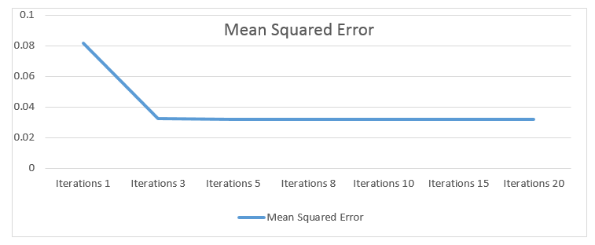
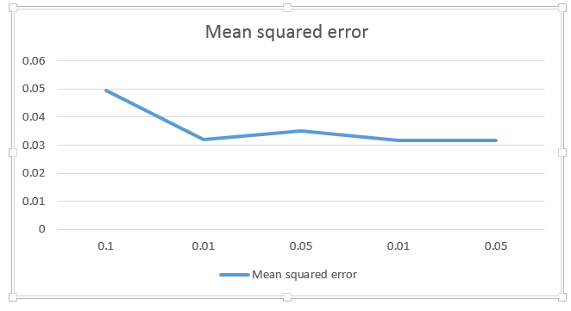
Experimental Methodology
Statistics
start time=> 10:53:14
end time =>10:55:40
total time taken : 2 min 26 seconds
MSE - 0.17

Slide 14
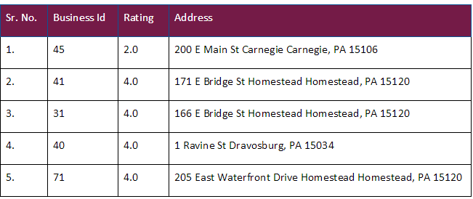
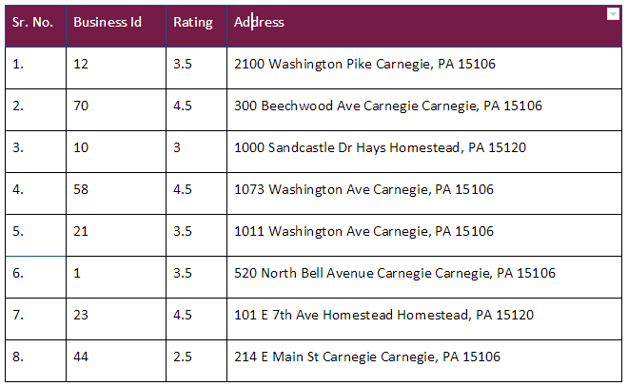
Ideas for Validation
Input: User 248
User 248’s ratings

Slide 15
Key Learnings
Spark SQL, Scala
Spark-MLLib library
Regression Line and its analysis
Collaborative filtering
How Does it work
What is matrix factorization model
How does ALS work
Designing of Architecture of Big Data Machine project
Documentation
charting the functional and non functional requirements
system diagram
Validation
Analysis of Result

Slide 16
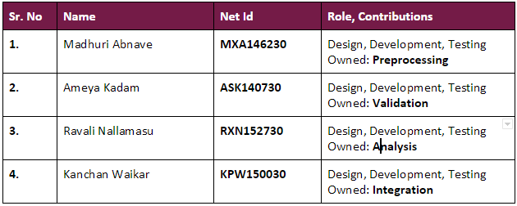
Key Roles

Slide 17
Any Questions?

Slide 18
Thank you!

